Slide 1
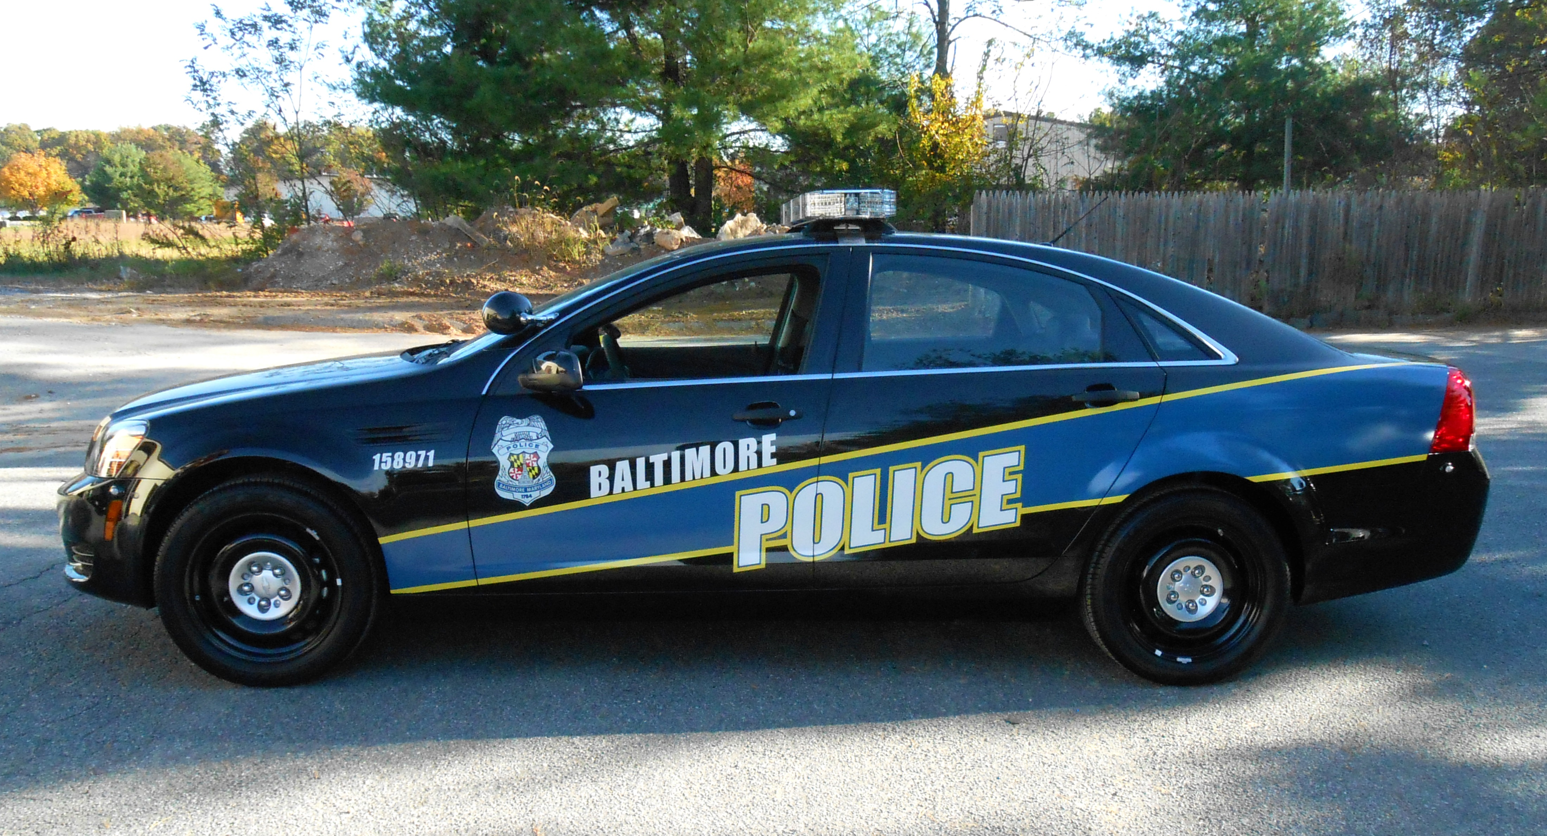
BALTIMORE POLICE DATA ANALYSIS
Presentation by:
Guangji Zou (Ray)
Tianyu Liu (Terry)
Hezi Fu (Helen)
Instructor:
Michael “Jack” Davis

Slide 2

Introduction
The purpose of this presentation is to make evidence-based decisions on how to improve public safety.
In our study, we attempted to pinpoint the locations within the city of Baltimore where the most serious events take place. We also briefly looked at the time of day of these events.
This will hopefully assist with the deployment of police forces to the most demanding locations and at the most needed times.

Slide 3
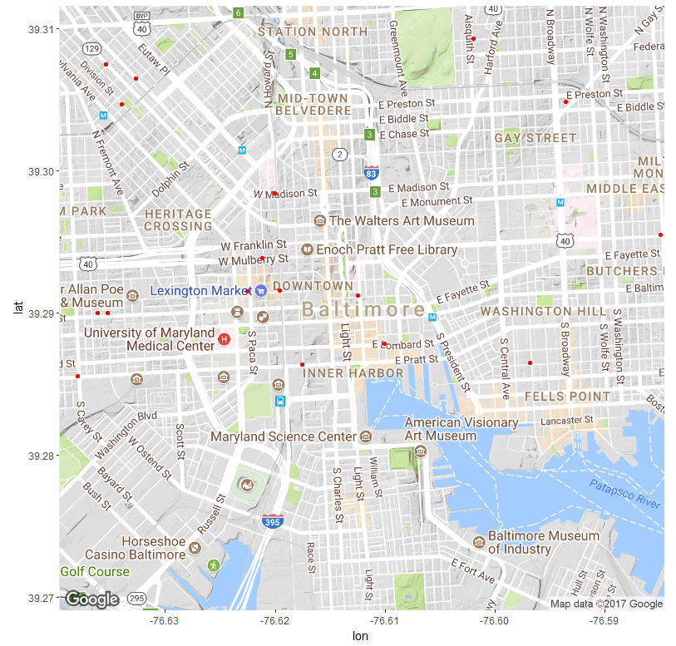

Data analysis - high priority incidents
This map shows the location of the calls considered to have the most priority, which means that these incidents is in need of police the most.

Slide 4
Data analysis - high priority incidents
From this map, we can see that there are three concentrated locations
near Upton station
in Downtown near Lexington Market
in an area just south of Edgar Allan Poe House & Museum.

Slide 5
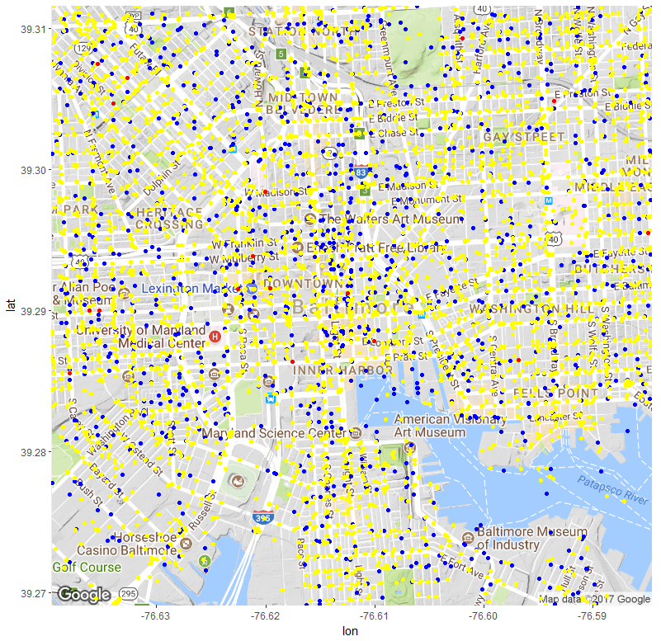
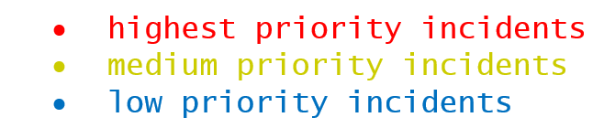
Data analysis - all incidents
This map presents all the incidents from the past 2 years around the vicinity of Baltimore. It is a very scattered plot thus we will not analyse it, and instead focus on the highest priority incidents only.

Slide 6
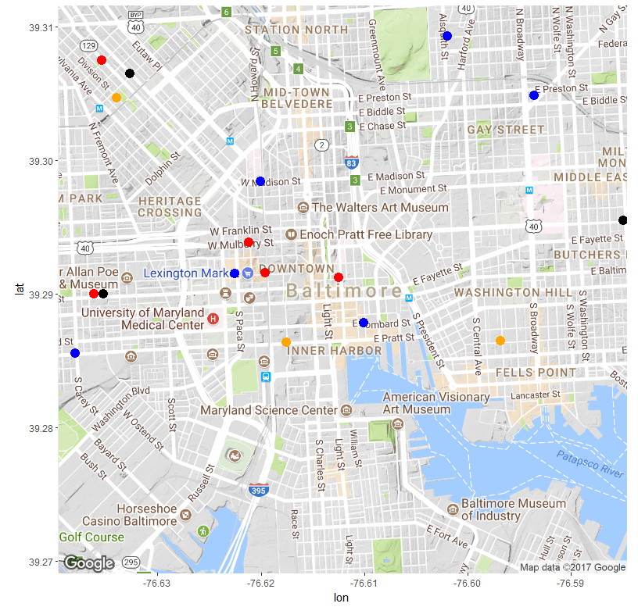
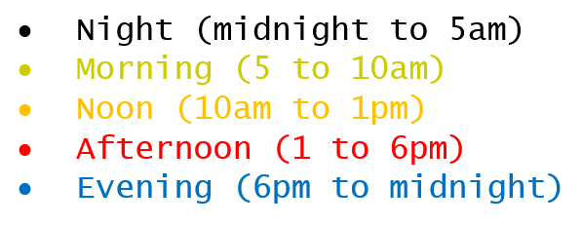
Data analysis - time of day
This plot presents the high priority incidents occurred during different times of the day.
It appears that in the Downtown area, most of the incidents occur during the afternoon and evening, but near Upton they mostly occur during daytime, and further away from downtown they mostly occur at evening to nighttime.

Slide 7
Conclusion
With the given dataset, we have utilized mapping devices to mount the location of the incidents onto a readable street map. This will hopefully be useful with assisting the police to make decisions regarding the improvement of public safety in Baltimore.

Slide 8
Conclusion - Drawbacks
One of the clear drawbacks of this study is that we here have only considered the incidents with the highest priority, as there are only 47 of them so the data does not get out of hand. In reality, the medium-priority incidents are just as significant and should not just be discarded.
Another drawback is that we have disregarded the type of incident, as we only focused on analysing the priority but did not emphasize on what actually happened.

Slide 9
Thank you for paying attention

